Slide 1
Fighting for the Future of the Social Web
Selling Out and Opening Up
Joseph Smarr
Member of Technical Staff, Google
Portland, OR – July 26th, 2011
http://profiles.google.com/jsmarr
http://twitter.com/jsmarr
http://josephsmarr.com

Slide 2
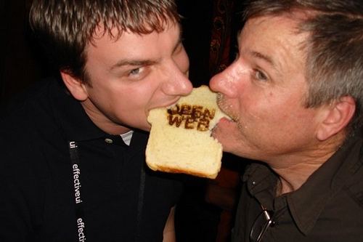
A bit about me…
Software Engineer at Google since 2010
  Worked a lot on Google+ (esp. circles & sharing)
  Also worked on Webfinger, Portable Contacts, Social Graph API, Buzz APIs
Former CTO of Plaxo (and first employee, joined 2002)
Long-time advocate and early adopter of Open Social Web
  Bill of rights (opensocialweb.org)
  Plaxo as early mainstream OpenID relying party
  OpenID / OAuth hybrid spec
  Portable Contacts spec
  Former board member, OpenID Foundation
  Former board member, OpenSocial Foundation

Slide 3
The obligatory disclaimer:
These are my personal views, not Google’s!

Slide 4
Is the social web actually opening up?
Is open web tech getting more useful & user-friendly?
Have open web proponents “sold out” to big companies?
Hint: “yes and no…”

Slide 5
But first…a brief reminder:

Slide 6


Slide 7
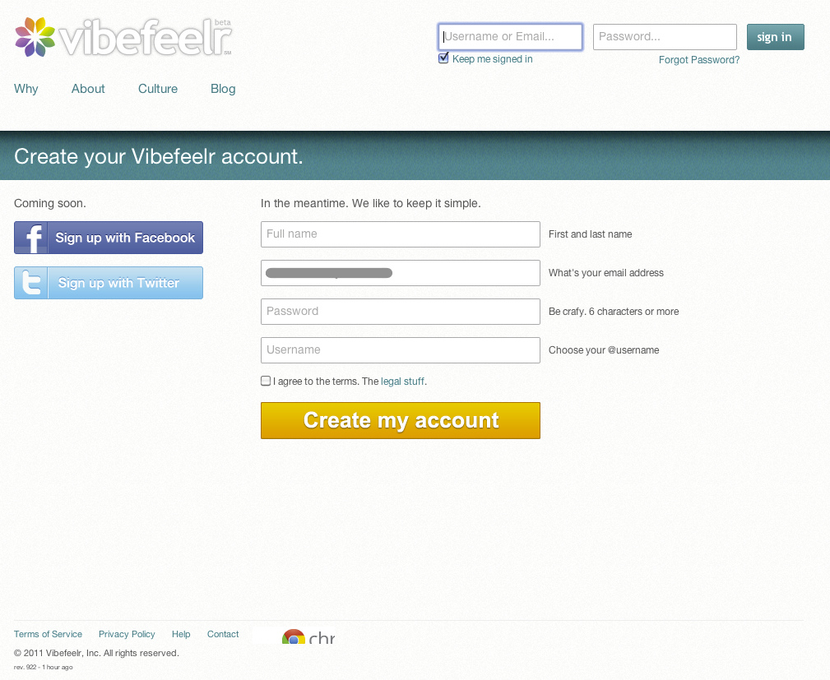
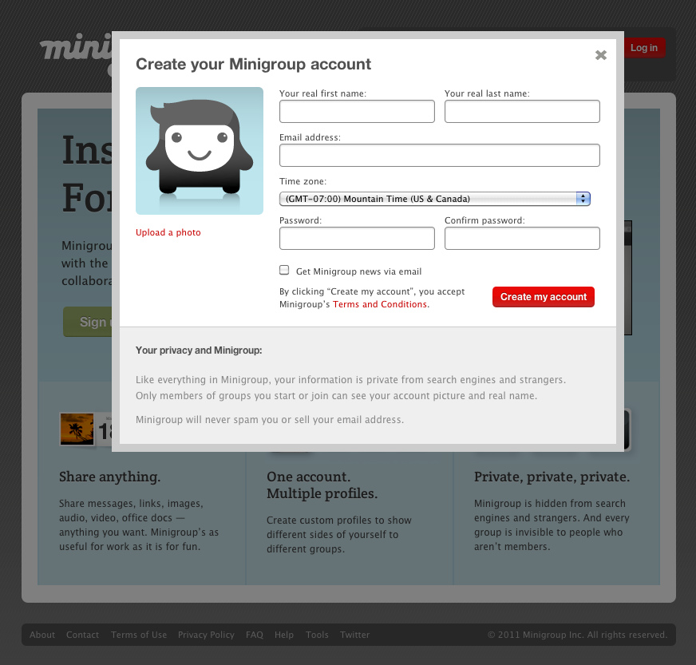
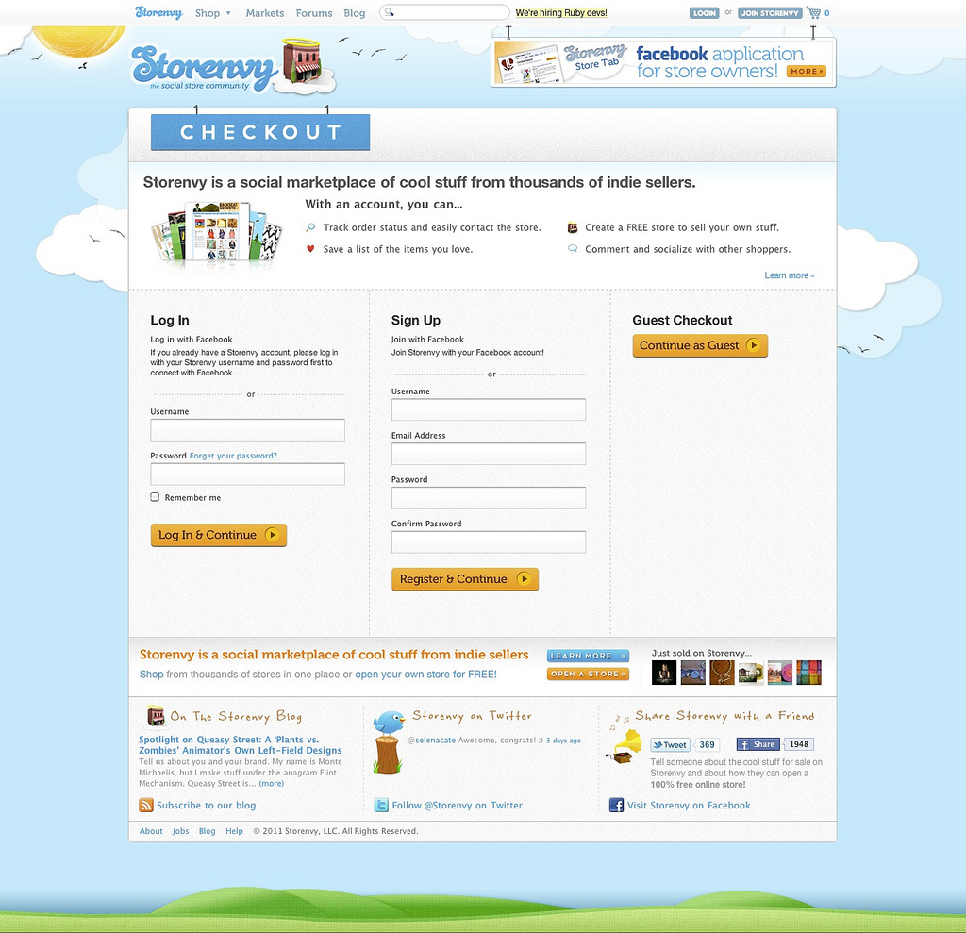
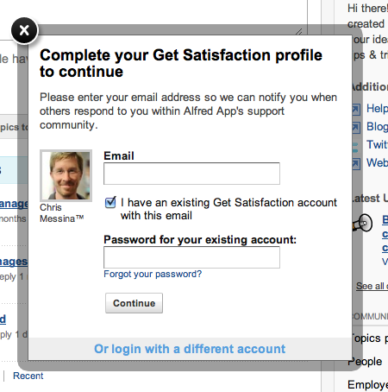

Slide 8
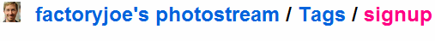
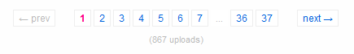

Slide 9
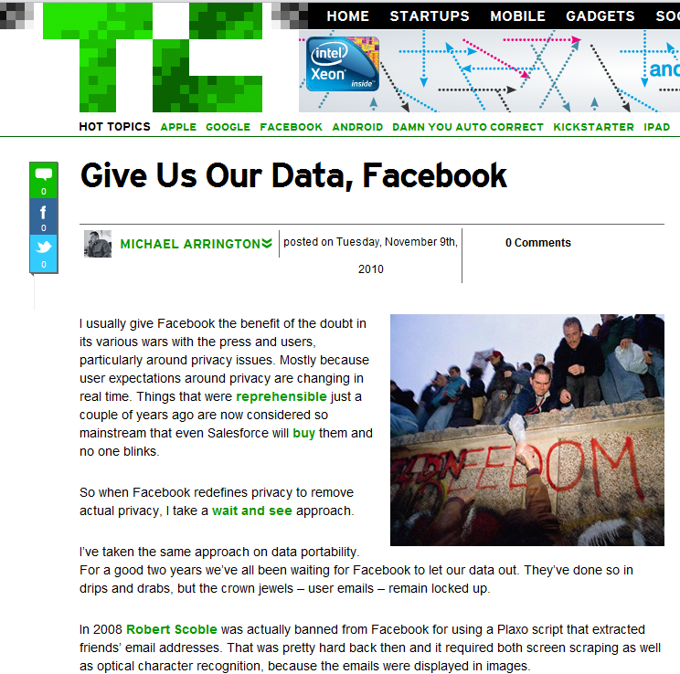
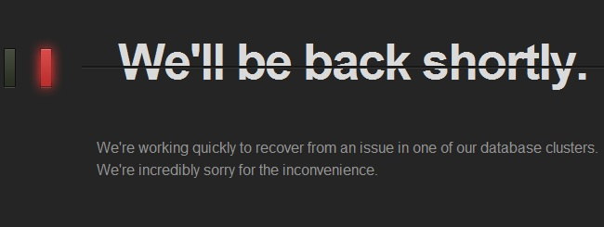
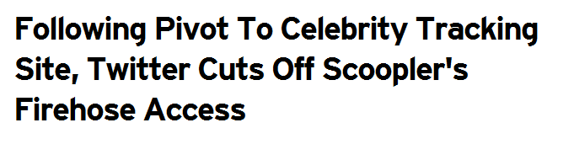

Slide 10
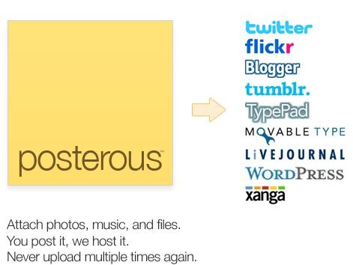
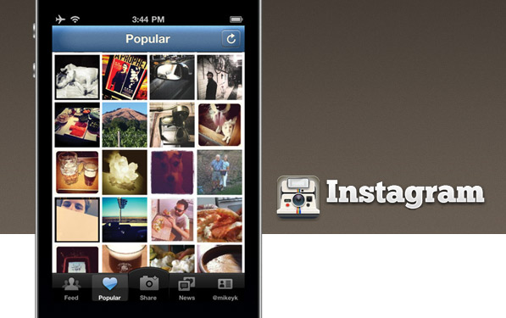
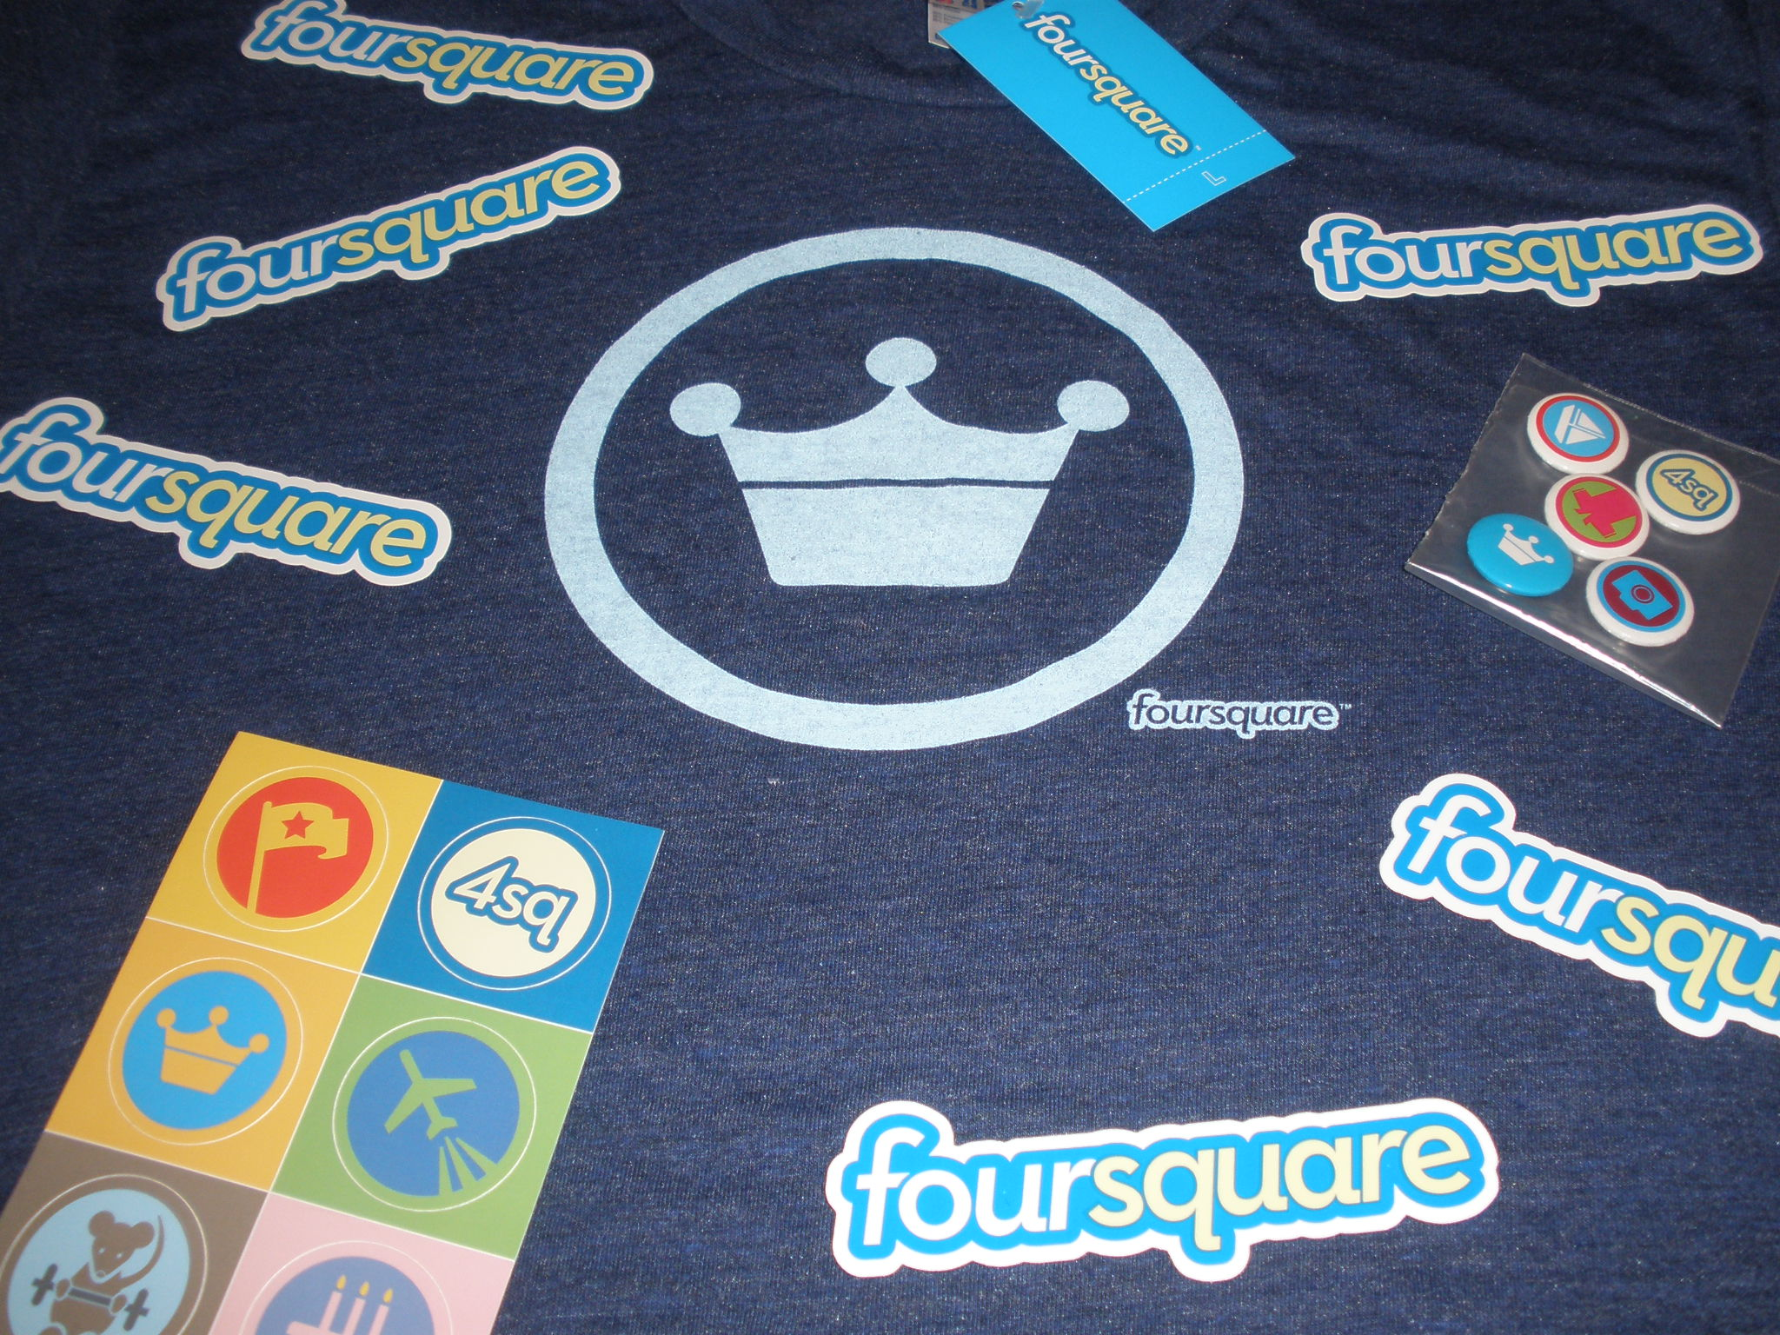
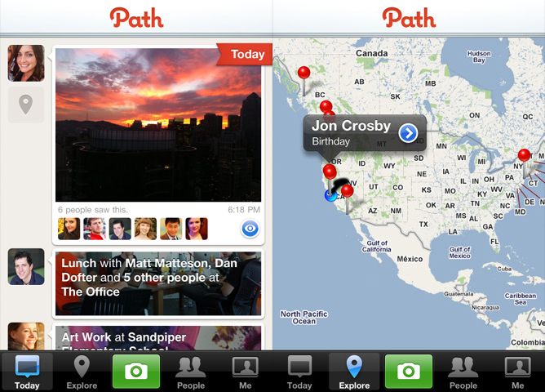
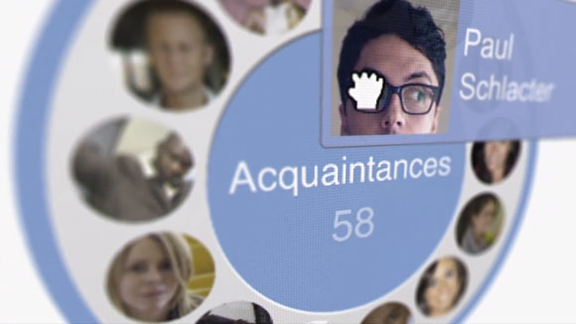

Slide 11
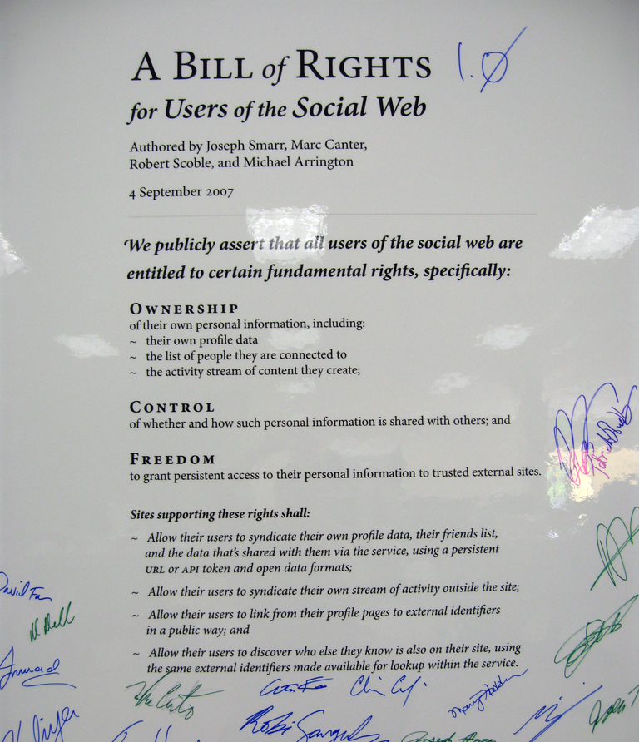
When will we have won?
Users can try new services without having to “start over” or leave their friends & data behind.
Users can connect across services that don’t know of each other (or like each other).
Developers can thrive in a “social web ecosystem” and quickly find success.
The social web is vibrant, innovative, and not owned by anyone (i.e. just like the web itself).

Slide 12
So…how are we doing so far?

Slide 13
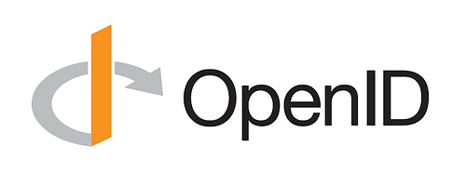


Slide 14
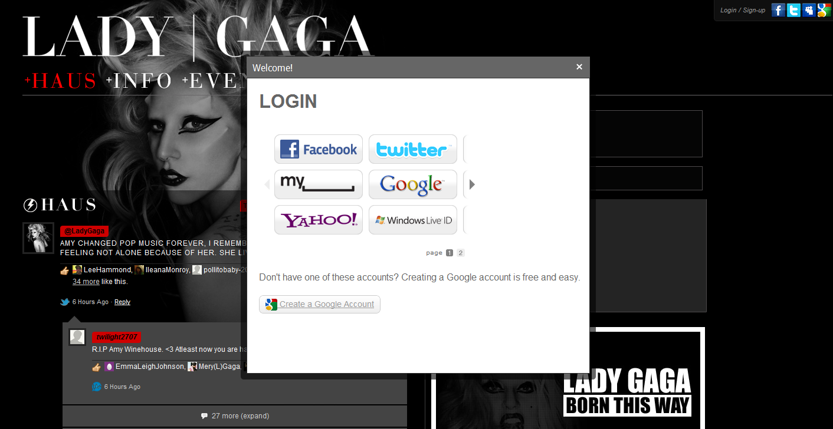
Notes:
Lots of sites allow OpenID login – even LadyGaga.com!

Slide 15
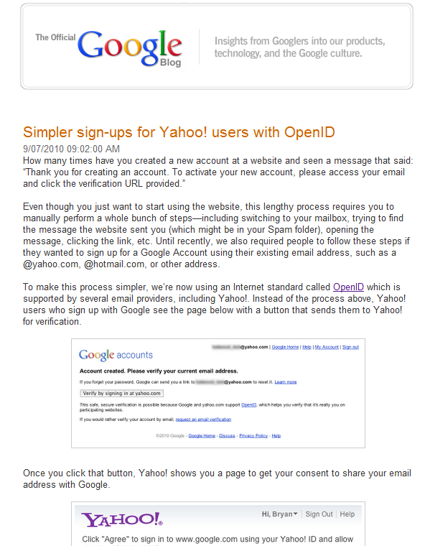
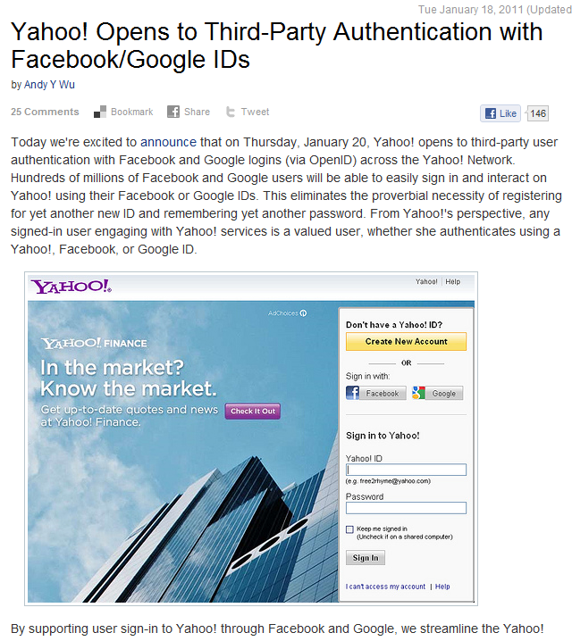
Notes:
Even big sites like Google and Yahoo are now relying parties – something many said would never happen

Slide 16
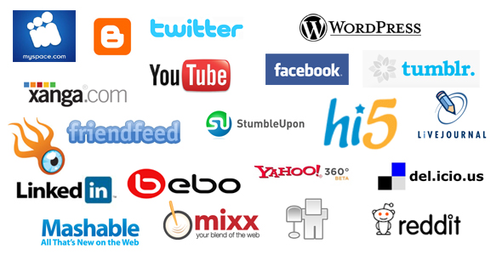
Random collection of “social site logos”
Nearly all support OpenID and/or OAuth
(or are out of business)
Notes:
I picked this random set of logos from the web, and they almost all support OpenID or OAuth.

Slide 17
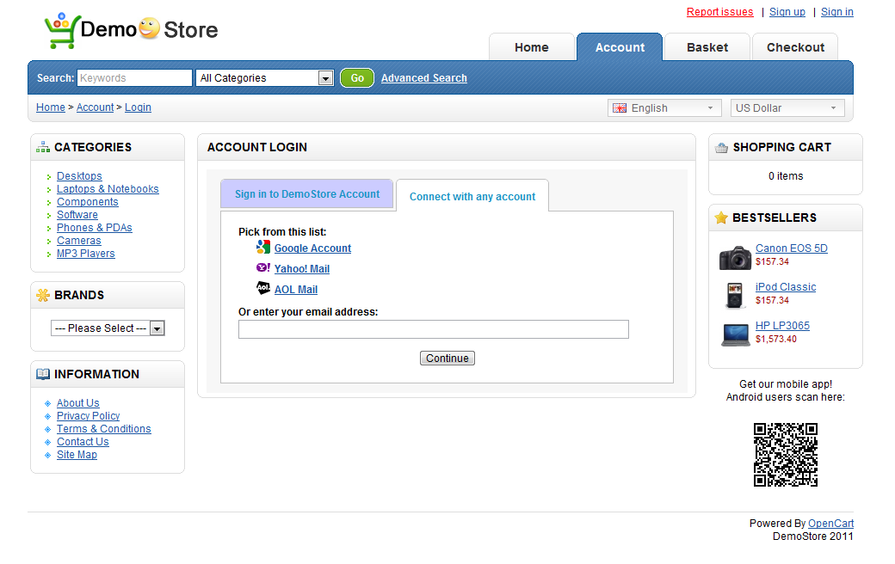
OpenIDSampleStore.com
Notes:
And there are open-source samples and best practices available, such as this site made by Googlers.

Slide 18
Sounds great! So…where’s the problem?

Slide 19
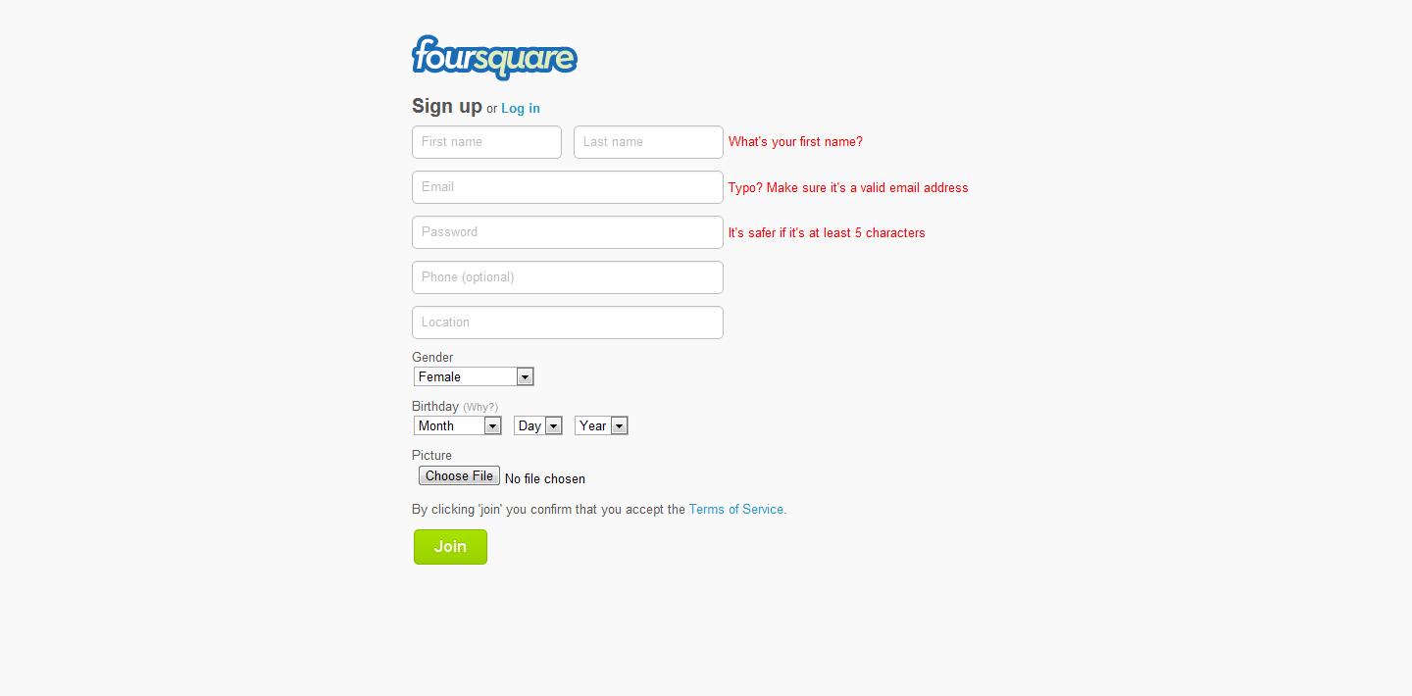

Slide 20
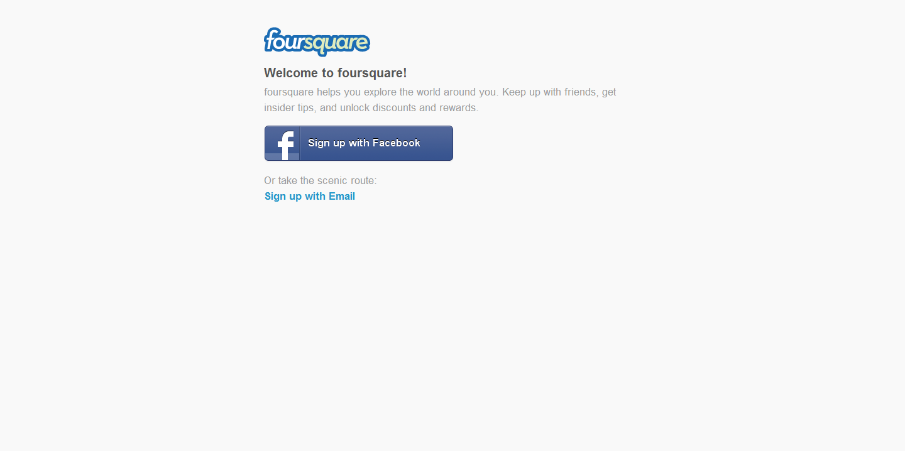

Slide 21
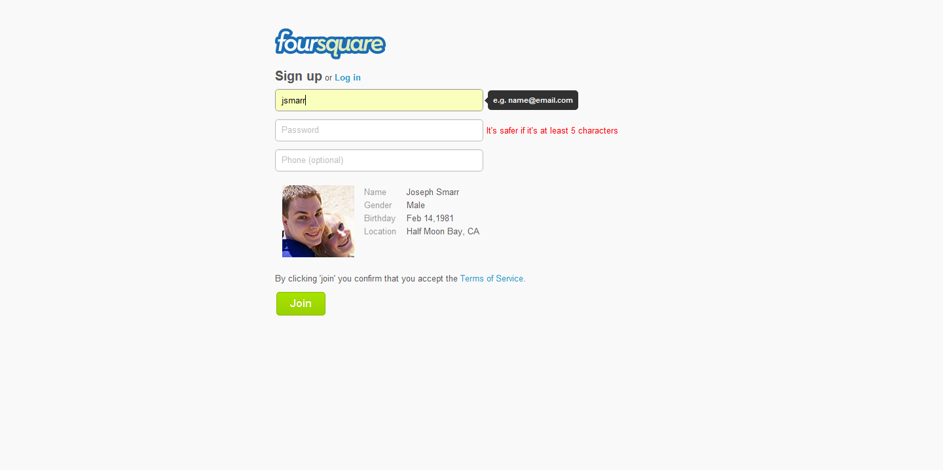

Slide 22
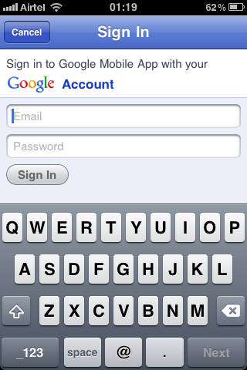
Notes:
Mobile UI is still lacking – how do I use my Yahoo account here?!

Slide 24
Notes:
Lots of sites allow OpenID login – even LadyGaga.com!

Slide 25
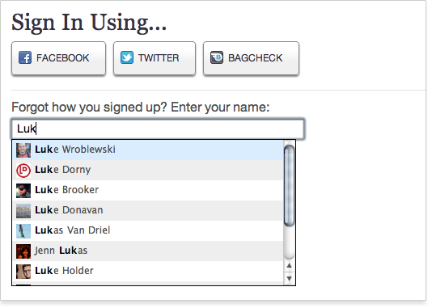

Slide 26
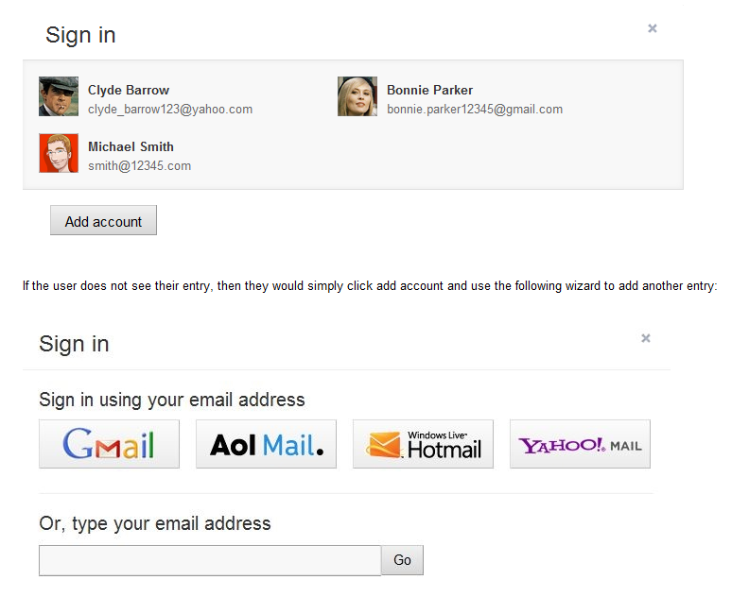
code.google.com/apis/identitytoolkit

Slide 27

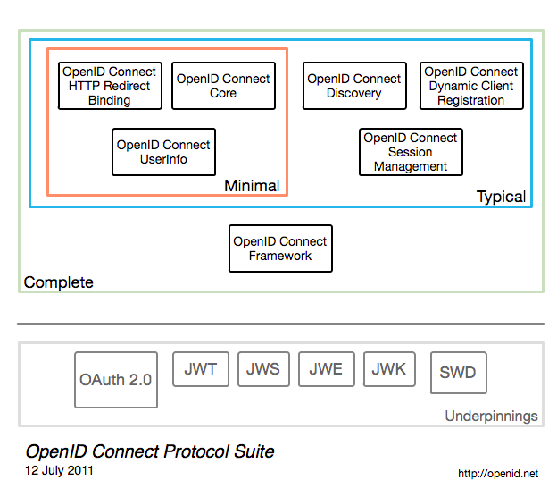

Slide 28
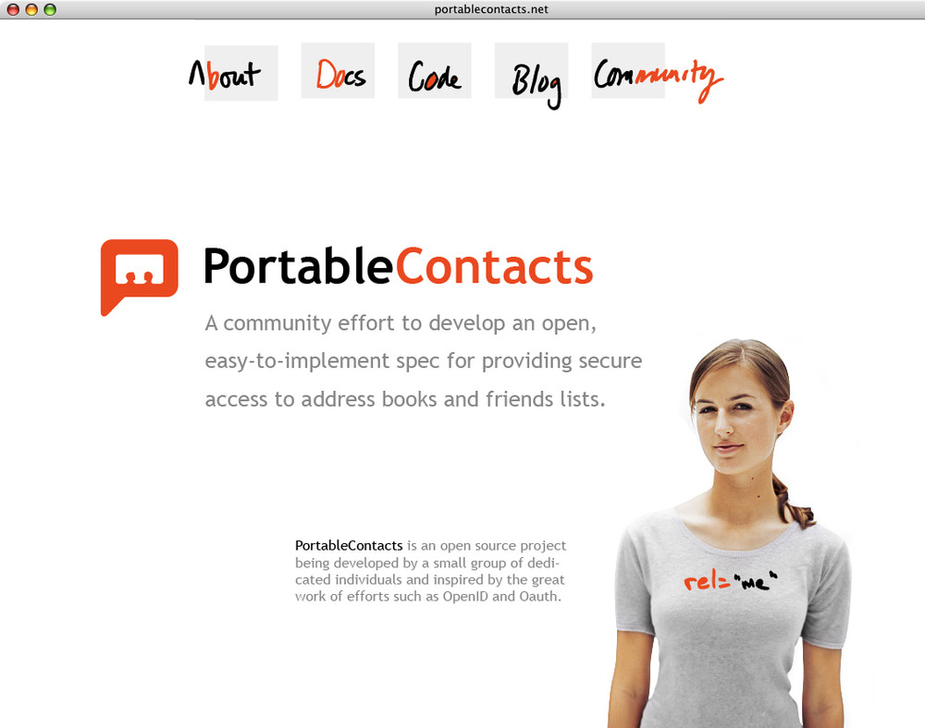
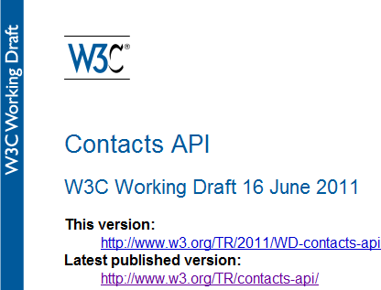
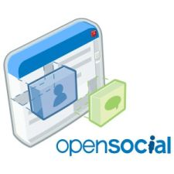
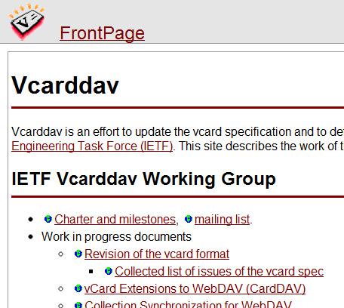
PortableContacts.net
Notes:
Case study: Portable Contacts. Many adopted it, influenced vCard 4 and W3C Contacts API, but still most APIs are incompatible, and worse, their Terms of Service prevent working with “any supporting provider”.

Slide 29
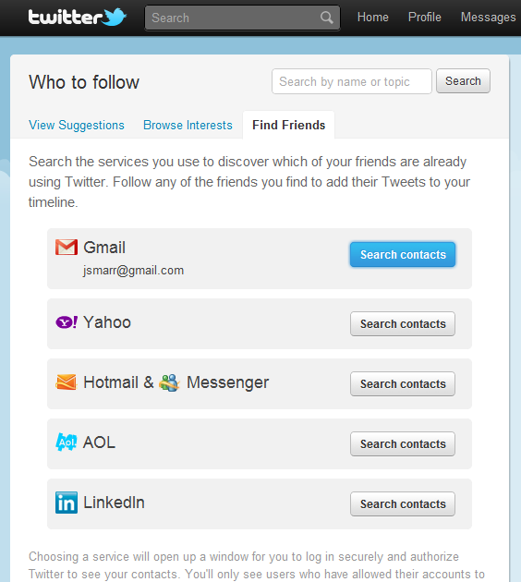

Slide 30
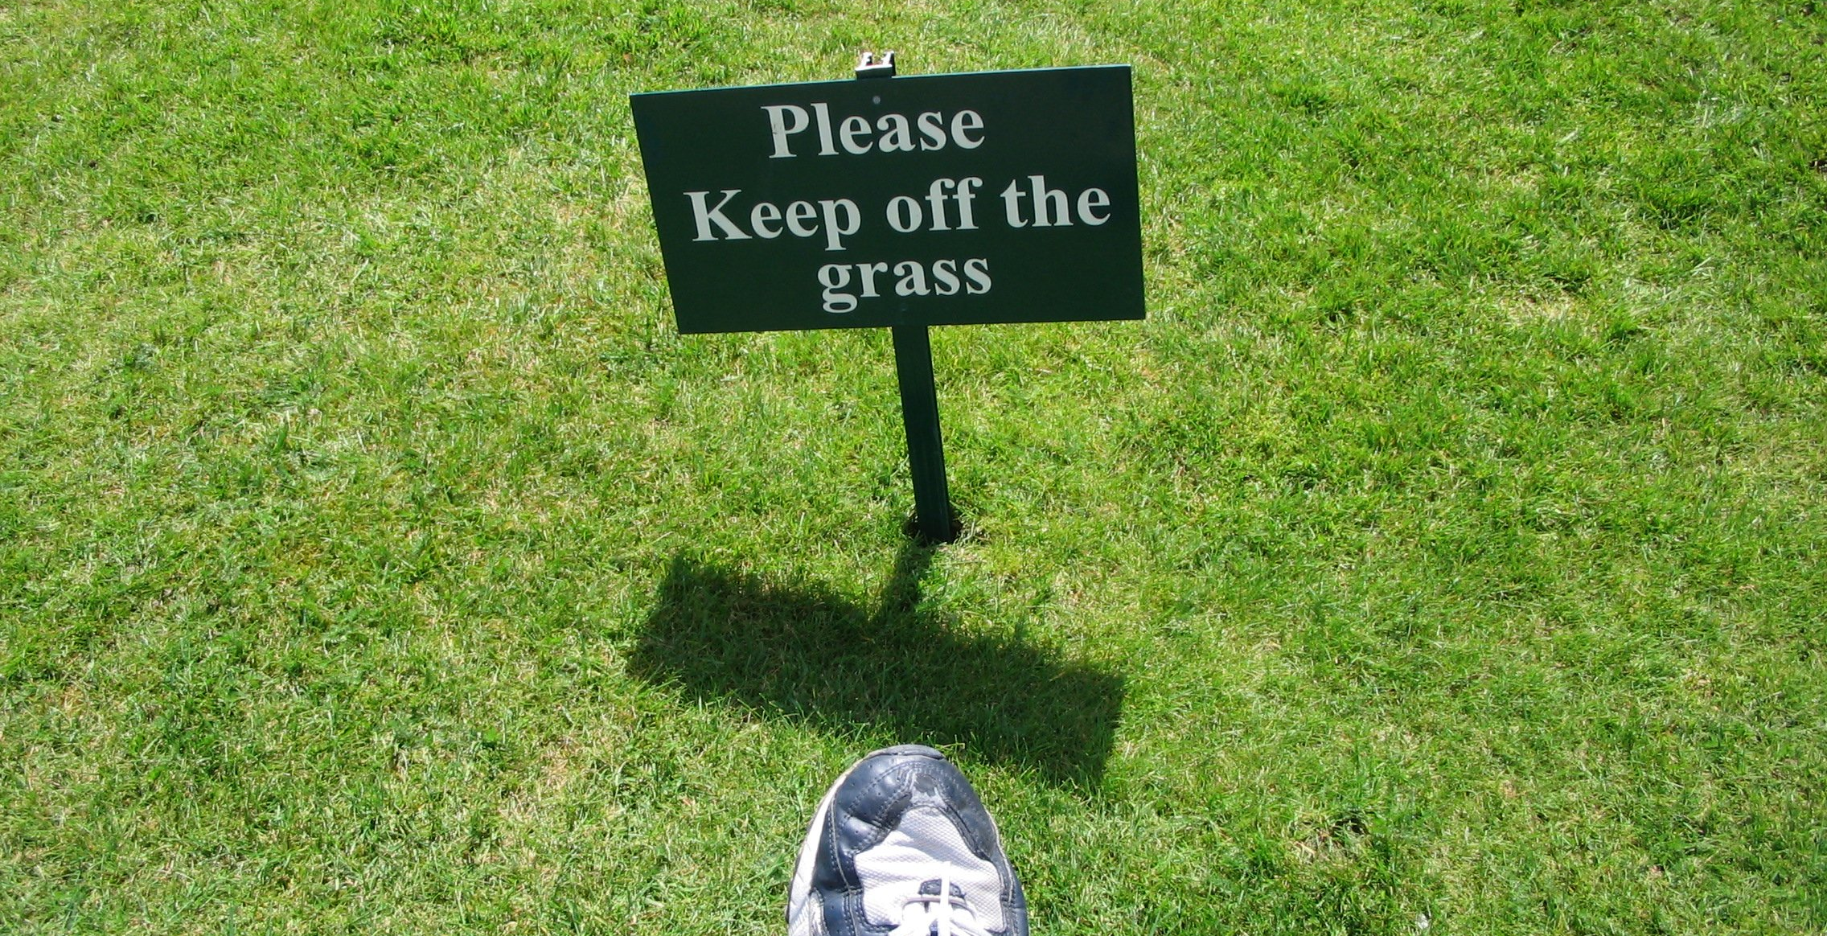
“@”
Notes:
It’s not enough to invent open protocols. We have to keep businesses from wrapping them in closed Terms of Service. Imagine if HTTP or SMTP worked like that!

Slide 31
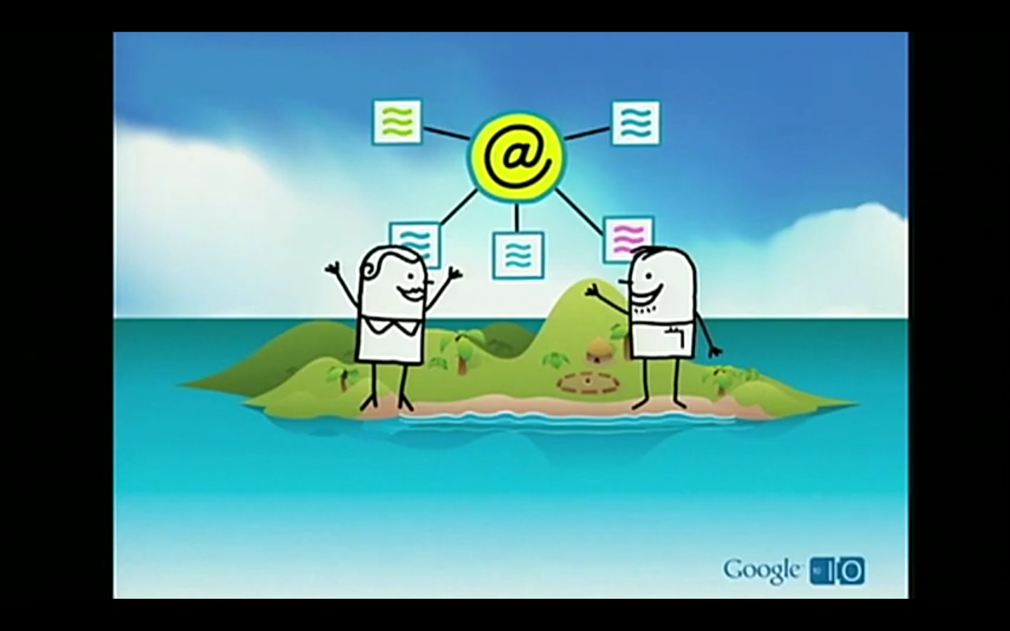

Slide 32
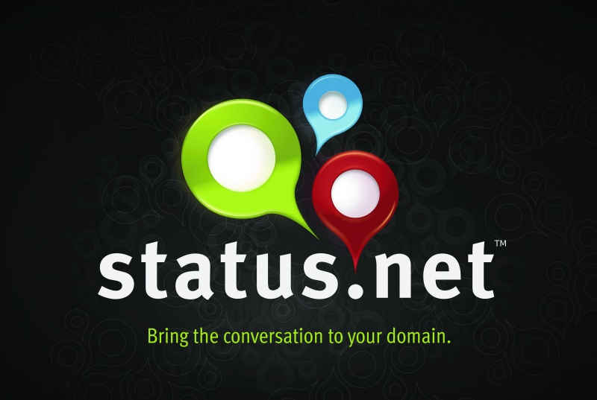

Slide 33
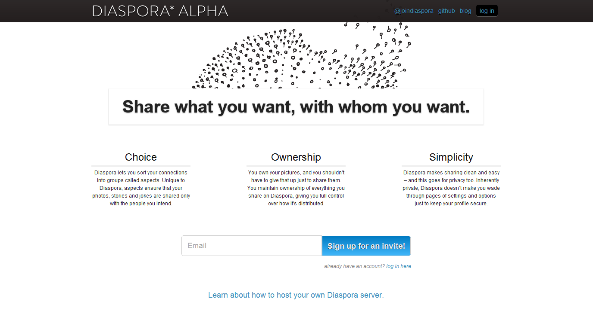

Slide 34
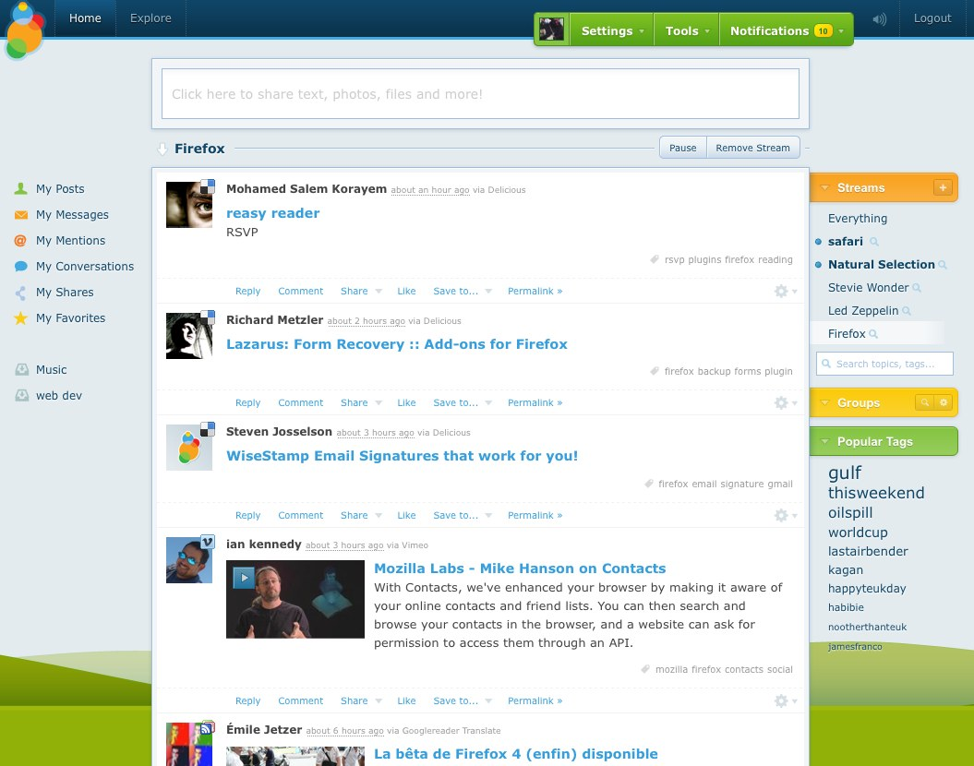

Slide 35
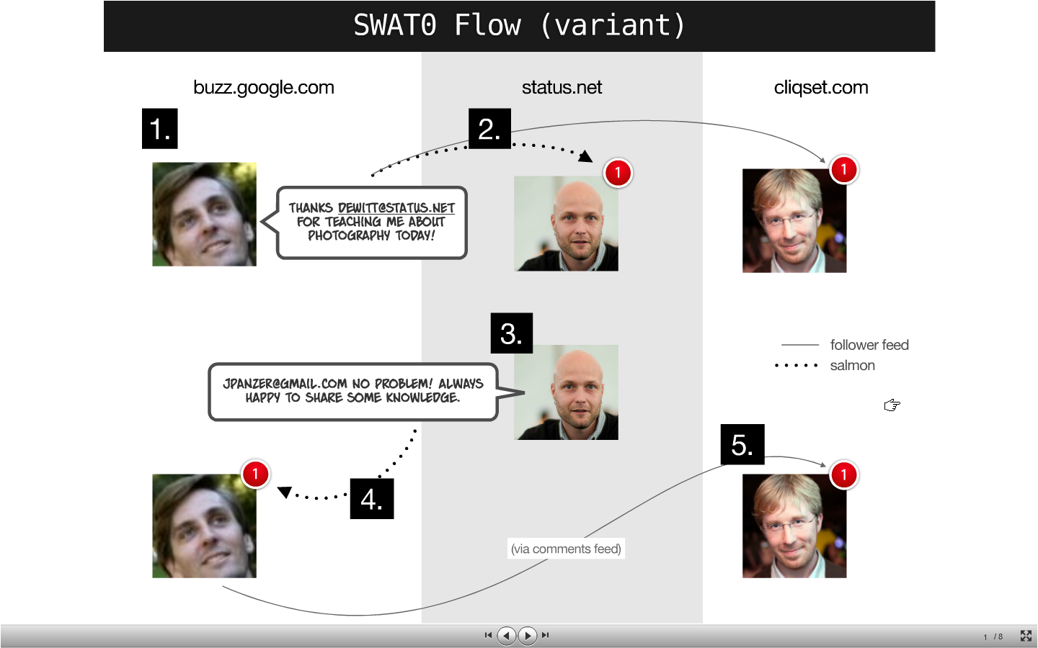

Slide 36
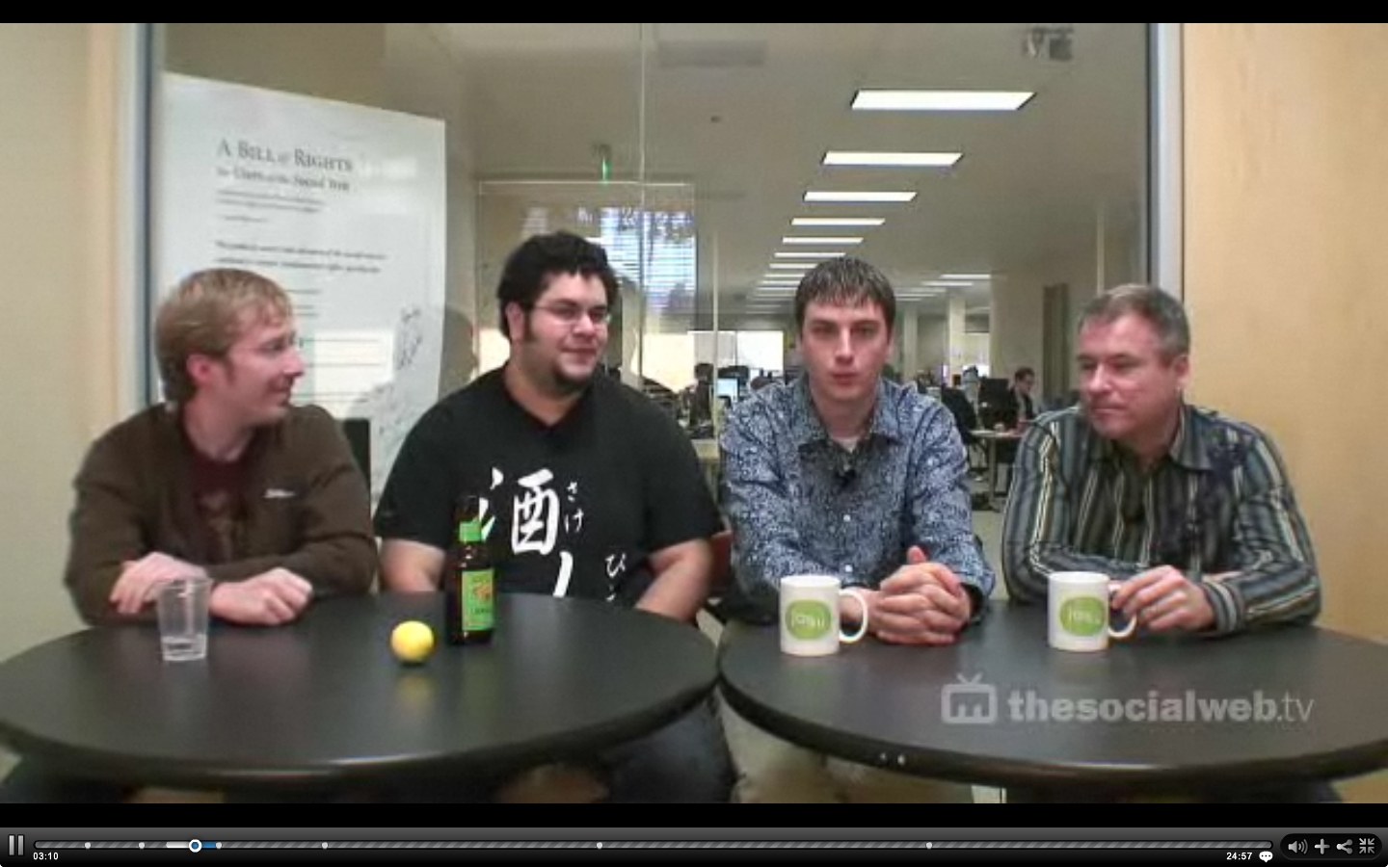




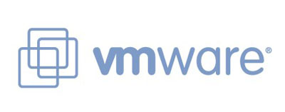

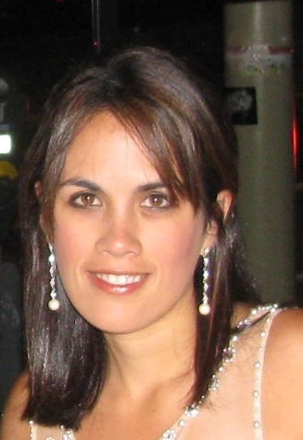


Notes:
Looks like all open social web advocates “sold out” to bigger companies in the past few years…

Slide 37
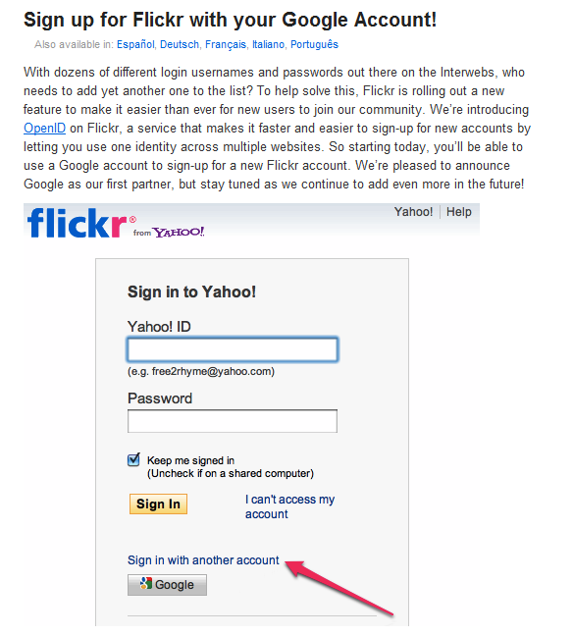
Notes:
But maybe it’s not all bad, when you see things like Yahoo’s flickr starting to take OpenID logins from Google.

Slide 38
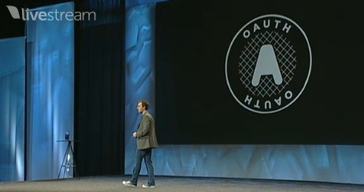
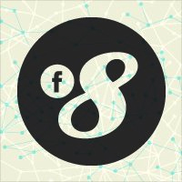
Notes:
And Facebook announced OAuth support at their next f8 after David joined.

Slide 39
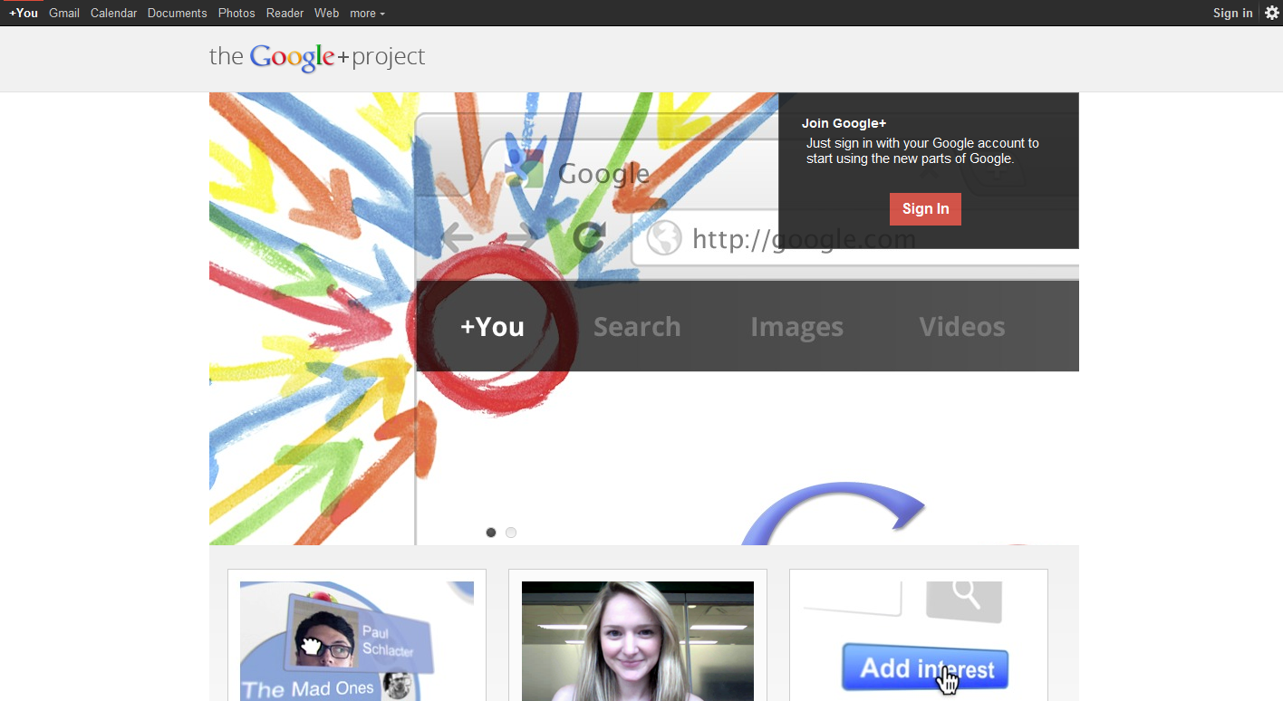

Slide 40
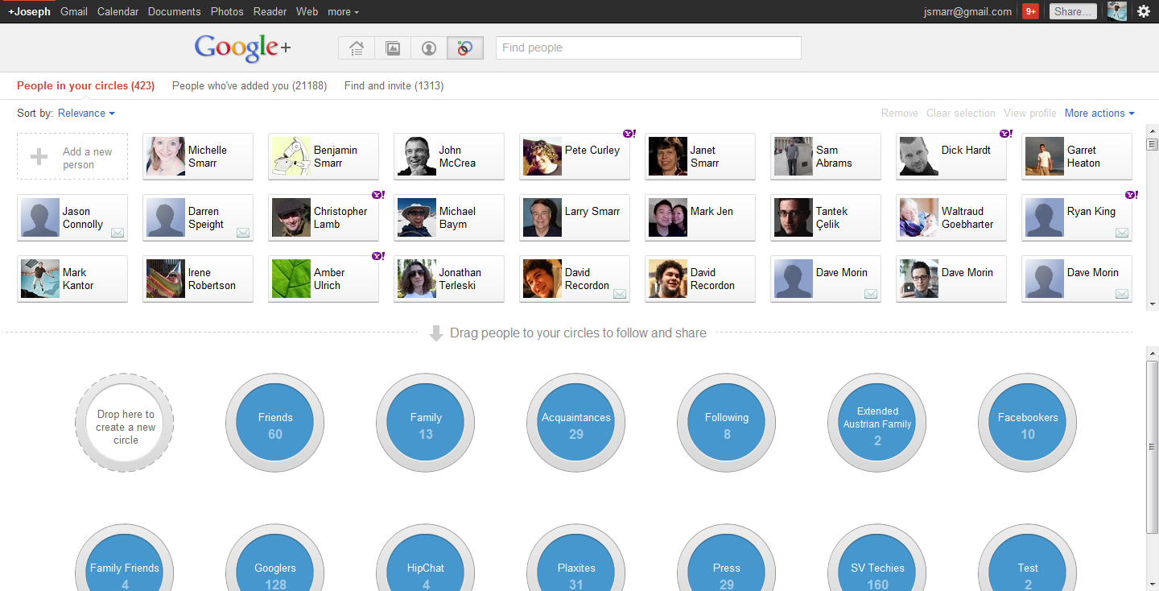
Notes:
Circles are “federation-friendly”: everyone maintains their own list (no bi-directional confirmation needed), you can find and connect to friends from other services (e.g. yahoo) and even add non-Google users to circles (via email). As protocols evolve, should be able to connect/share/comment across sites.

Slide 41
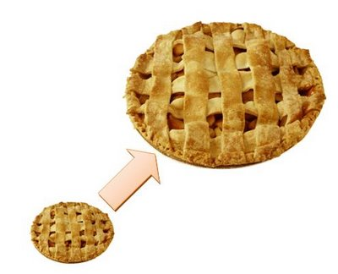
Notes:
Circles are “federation-friendly”: everyone maintains their own list (no bi-directional confirmation needed), you can find and connect to friends from other services (e.g. yahoo) and even add non-Google users to circles (via email). As protocols evolve, should be able to connect/share/comment across sites.

Slide 43
Is the social web actually opening up?
Is open web tech getting more useful & user-friendly?
Have open web proponents “sold out” to big companies?

Slide 44
Is the social web actually opening up?
Is open web tech getting more useful & user-friendly?
Have open web proponents “sold out” to big companies?
Answer:
We’re making solid progress.
But we all need to keep pushing.
The future is still ours to build.

Slide 45

If you want an open future, do something about it.
Notes:
Users should demand more control over their data, and developers should gravitate to platforms that more open.

